Slide 1

Exploring City Bike’s Data

Slide 2






Jason Yip
Jerald
Desmond Chay
James Liu
Citi Bike’s Data Science Team

Slide 3
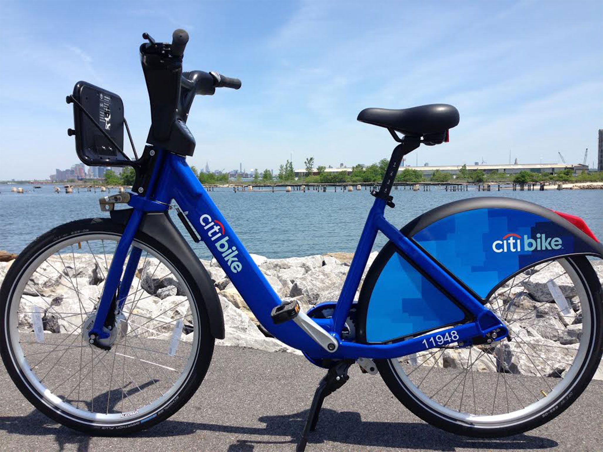
CitiBike
We are a privately owned public bicycle sharing system from New York, and the largest bike sharing program in the United States.
In our first year in 2013, there were 100,000 subscribers and an average of 14,867 rides per day. Our company has continued to expand at an accelerating rate.

Slide 4

Our Task
It is 2016 now and we were tasked by the Chief Growth Officer to explore the data to come up with valuable insights to support our expansion later this year.
Our team will use analytical methods learnt from the Decision Making Methods & Tools class taught by the renowned Professor Um of NUS School of Computing.
Descriptive Statistics
K-Means Clustering
Panel Data Analysis
Time-Series Forecasting

Slide 5
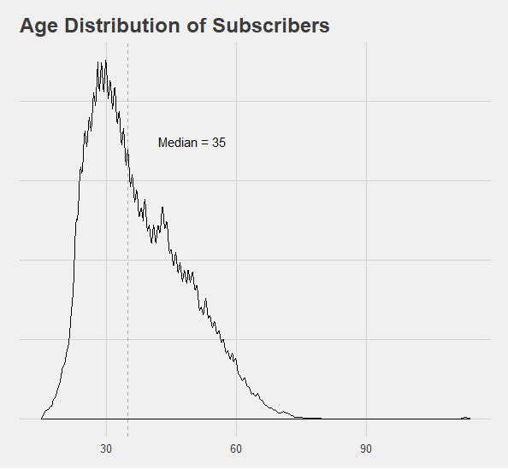
Descriptive Analysis & Quick Insights
Most of the trips are made by subscribers who are around age 35.
This finding could be useful in customizing the promotion of our subscription service to suit the tail-end age groups more and maximize subscription rates.

Slide 6
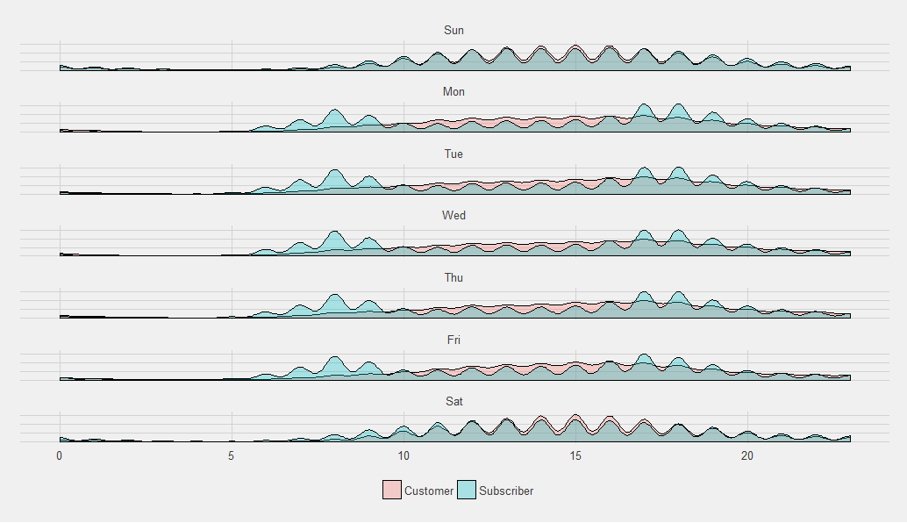
Descriptive Analysis & Quick Insights
Frequency of trips made by subscribers peak during near peak hours (8am / 5pm)
Frequency of trips made by non-subscribers are higher during non-peak hours
We can thus deduce that most subscribers use it for commute to work since most of the trips are made by those aged 35 as well
How subscribers and non-subscribers affect the hourly distribution of rides

Slide 7

Unsupervised Learning with K-Means Clustering
Hypothesis
There is a relationship between trip duration and:
Subscriptions
Riders’ Age
Start-station locations

Slide 8

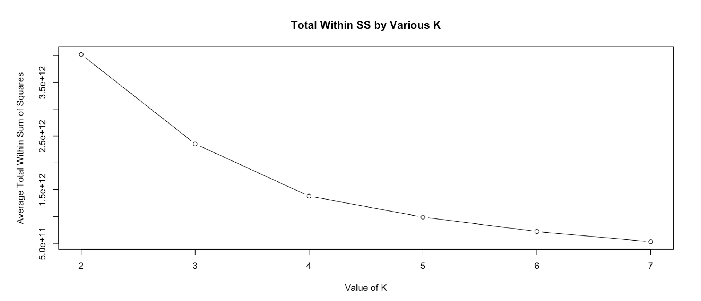
Preparation for Clustering
Dropping unsuitable columns
Determinining number of clusters

Slide 9
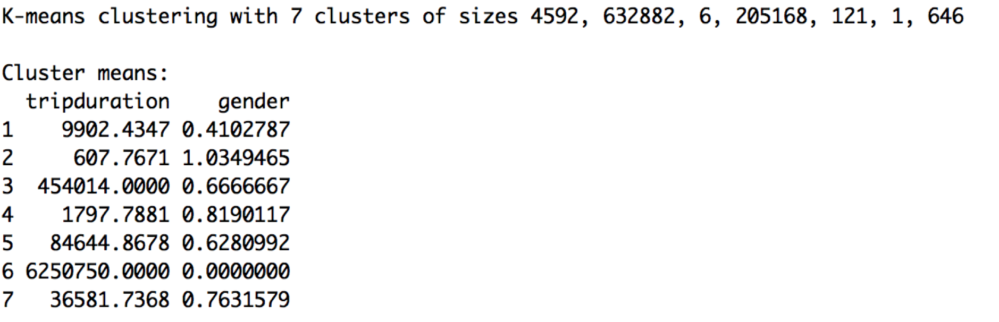
Output
2 large groups: Group 2 & Group 4

Slide 10
1. Subscribers are more likely to make shorter trips
Proportion | Group 2 | Group 4
Customers | 94973 (0.15%) | 76438 (0.37%)
Subscribers | 537909 (0.85%) | 128730 (0.63%)
Mean trip duration of
Group 2: ~10mins
Group 4: ~30mins
Proportion of subscribers were higher and the rides took a shorter time on average in group 2. Therefore, we can deduce that subscribers were more likely to make shorter trips.

Slide 11

2. No relation between Trip Duration and Age
Average Birth Year of
Group 2: 1975.598
Group 4: 1974.9
Since groups were clustered by difference in trip duration and they seemed to have similar average birth years, there might not be a distinct association.

Slide 12
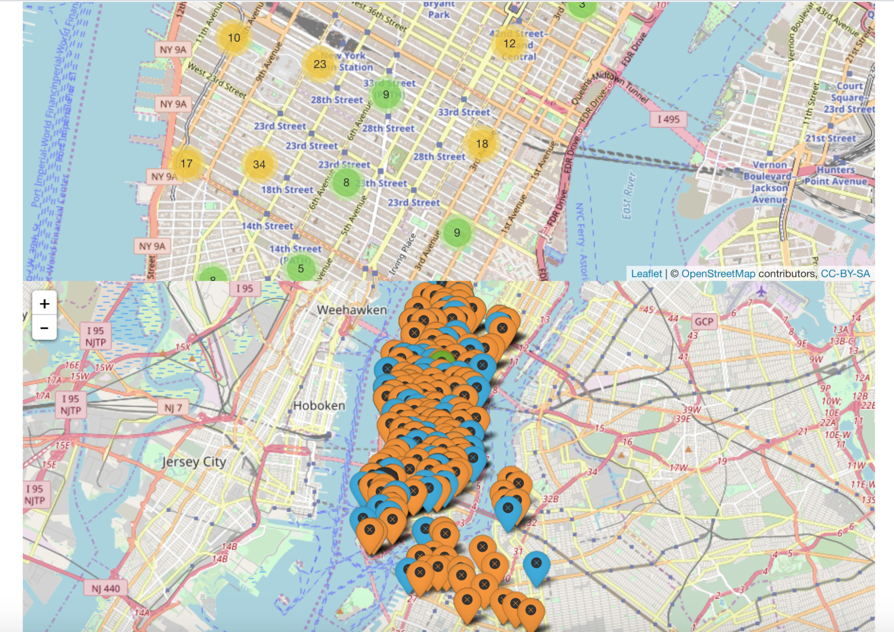
3. No relation between Trip Duration and Location

Slide 13
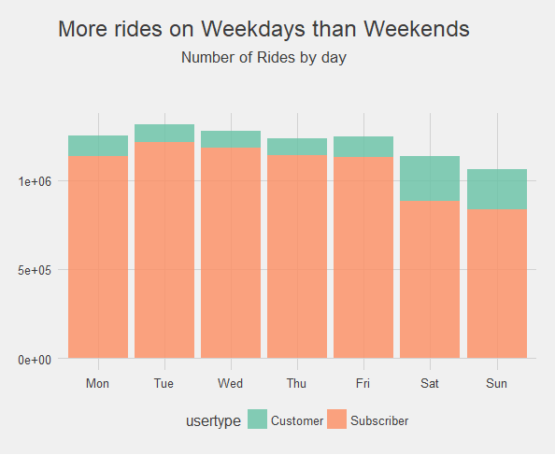
Distribution of Rides for understanding Consumer Segments

Slide 14

Business Insights
Subscribers make shorter trips and they travel on weekdays more: pragmatic purposes, transitioning between other transport modes.
Non-subscribers make longer trips and their proportion increases during weekends: might be tourists, would not want to pay for subscription.
Citi Bikes should focus on understanding our consumer segments better. We should concentrate on discovering the purpose of different rides instead of the rider’s age and location to improve targeted advertising.

Slide 15
Exploring other effects on predicting Trip Duration
with panel data analysis
Hypothesis
Is Trip Duration affected by age and the weather?

Slide 16

Processing the data
Took averages by Start Station IDs across months
Converted the scale of Duration from seconds to minutes
Filtered out only the data from Subscribers
Converted riders’ Birth Date to Age
Filled missing data with previous-known values
DV: average duration in minutes per trip
IVs:
average rider’s age
average daily precipitation (inches)
average daily snow depth (inches)
average daily maximum temperature
average daily wind speed (m/s).

Slide 17
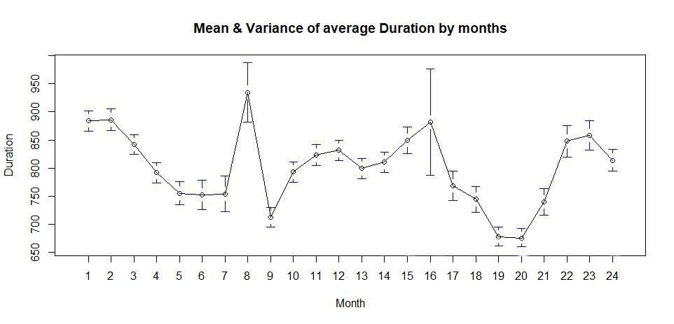
Heterogeneity across Stations

Slide 18
The Case for Panel Data Analysis
Segment the data into cross-sectional units (333 unique Bike Stations) over a period of time (24 months).
Panel data analysis is usually done on a small number of observations over time on usually a large number of cross-sectional units.
Can account for unobserved factors that do not change over time
- how steep the location of the station is (whether it is on top of a hill)
- how crowded the area around the station is
- how many bents that are nearby

Slide 19
Fixed Effects vs Random Effects
Hausman Test
data: Duration ~ Age + Precipitation + SnowDepth + MaxTemp + WindSpeed
chisq = 1.259, df = 5, p-value = 0.9391
alternative hypothesis: one model is inconsistent
p-value = 0.9391 > 0.05.
Winner: Random Effects model
Random Effects model should be used when the unobserved factors (steepness, crowdedness) are uncorrelated with the independent variables (age, weather).
?

Slide 20
Accounting for Multicollinearity
Correlation matrix
 | Duration | Age | Precipitation | SnowDepth | MaxTemp | WindSpeed
Duration | 1.0 | -0.11 | -0.015 | -0.029 | 0.14 | -0.15
Age | -0.11 | 1.0 | 0.030 | 0.10 | -0.21 | 0.21
Precipitation | -0.015 | 0.030 | 1.0 | 0.10 | -0.25 | 0.29
SnowDepth | -0.029 | 0.10 | 0.10 | 1.0 | -0.61 | 0.47
MaxTemp | 0.14 | -0.21 | -0.25 | -0.61 | 1.0 | -0.92
WindSpeed | -0.15 | 0.21 | 0.29 | 0.47 | -0.92 | 1.0
Affects our ability to single out the effects of an individual variable.
High wind speeds associated with lower temperatures
extra information is redundant.
WindSpeed (**p<0.05) is a less significant variable than MaxTemp (***p<0.01), we could drop it.

Slide 21
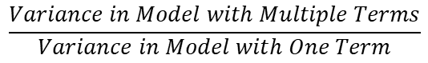
Variance inflation factor (VIF)
Before Age Precipitation SnowDepth MaxTemp WindSpeed
1.181740 1.094342 1.723731 8.304875 6.778088
After Age Precipitation SnowDepth MaxTemp
1.176431 1.074530 1.608169 1.918919
VIF decreased significantly from before and suggests that multicollinearity does not distort the coefficients as much now.

Slide 22
Regression Equation
Duration = -0.126*Age + 2.16*Precipitation + 0.161*SnowDepth + 0.0521*MaxTemp + 14.5
1 year ↑ in Age = 7.6s ↓ in Trip Duration
1 inch ↑ in Daily Precipitation = 2.2min ↑ increase in Trip Duration
1 inch ↑ in Daily Snow Depth = 9.6s ↑ in Trip Duration
1F ↑ in Daily Max Temperature = 3.1s ↑ in Trip Duration

Slide 23
Assumptions
1
The Panel Data model assumes a multi-linear relationship between the variables.
Other variables (purpose of trip) could affect trip duration, which was what we suggested.
The data is also aggregated and may also be subjected to sampling error.
2
3

Slide 24

Business Insights
Prices of rides can be determined by trip duration.
This could help Citi Bike with dynamic pricing and fine-tuning their algorithm for calculating price per unit duration based on daily weather conditions and the profile of their riders.

Slide 25

Forecasting Bike Demand
with ARIMA
Notes:
Next, i would like to touch on forecasting of bike demand using ARIMA model

Slide 26
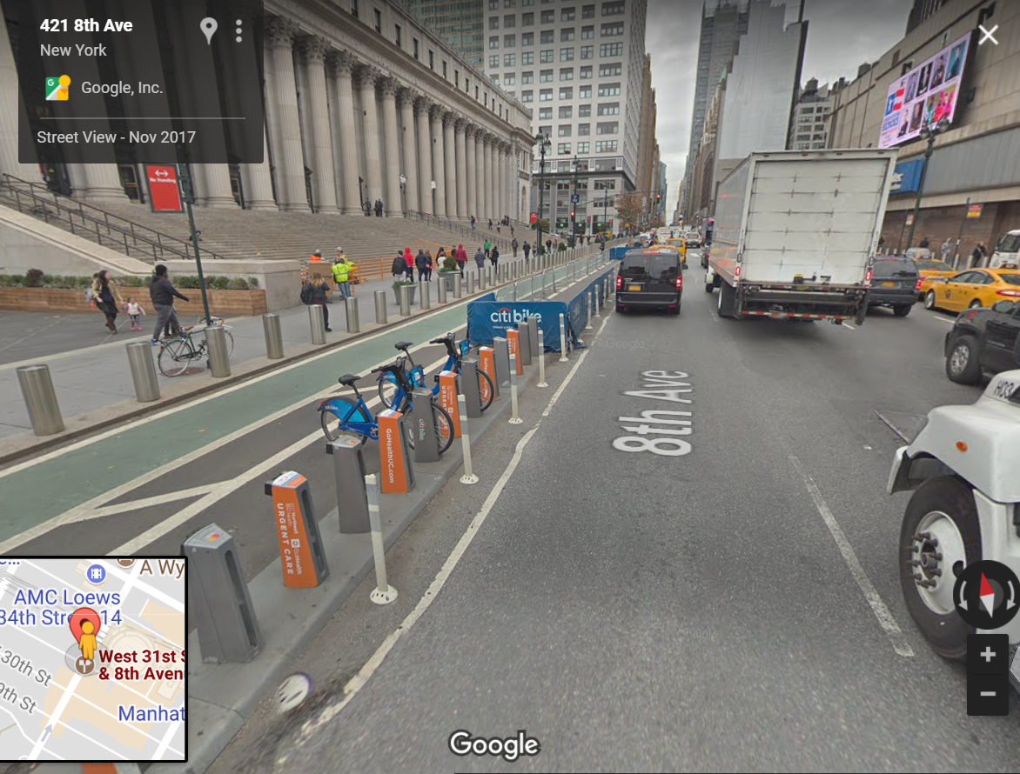
Finding the Most Popular Bike Station
Determined the top 3 stations with the most number of trips for each month.
Obtained the station which appeared in the top 3 for the most number of times.
Result: 8 Ave & W 31 St is the most popular station.
Notes:
We have decided to location the top 3 locations with the most number of starting trips from July 2013-June 2015.
Following which,we would obtain the station that appeared the most number of times in the top 3 category.
8 Ave & W 31 st is the most popular site.

Slide 27
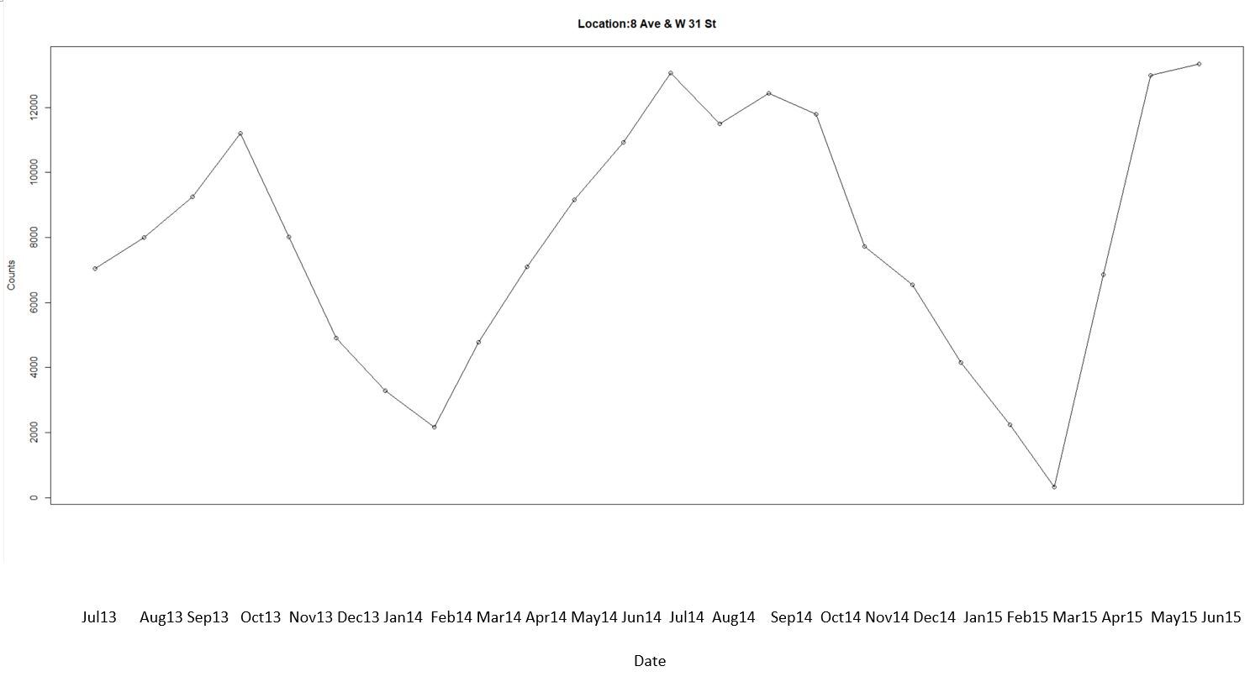
Visualizing the Time-Series
No clear trend + Presence of seasonality
Notes:
This is a trend that was plotted across the 2 years. From here we can see that there is no clear signs of trend but seasonality.

Slide 28
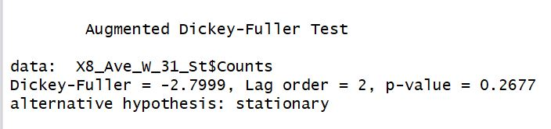
Test for Stationarity
Non-Stationary model could be a better fit
Notes:
The first thing we would do is to test for stationary using the Dickey fuller test. Since p value is greater than 5% significance level, we do not reject the null hypothesis: Non-stationary model.

Slide 29
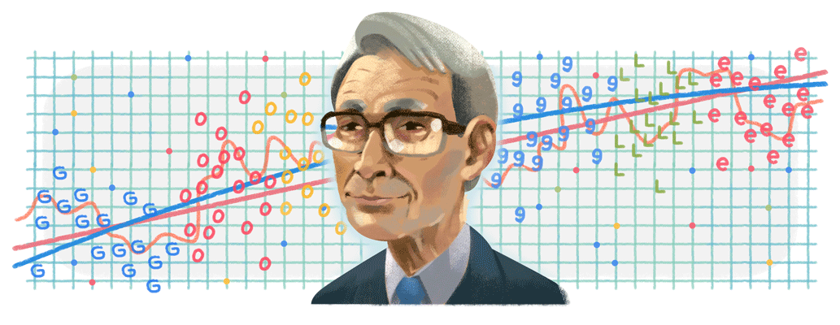
Finding the optimum ARIMA(p,d,q) model
Auto-arima function generated ARIMA(2,0,0)
Lowest Akaike Information Criterion
Highest likelihood in predicting values relative to other models
Notes:
Next, we try to look for the optimal ARIMA model (2,0,0). Since it has the lowest Akaike information criterion, it has the highest likelihood in predicting values relative to other models.

Slide 30
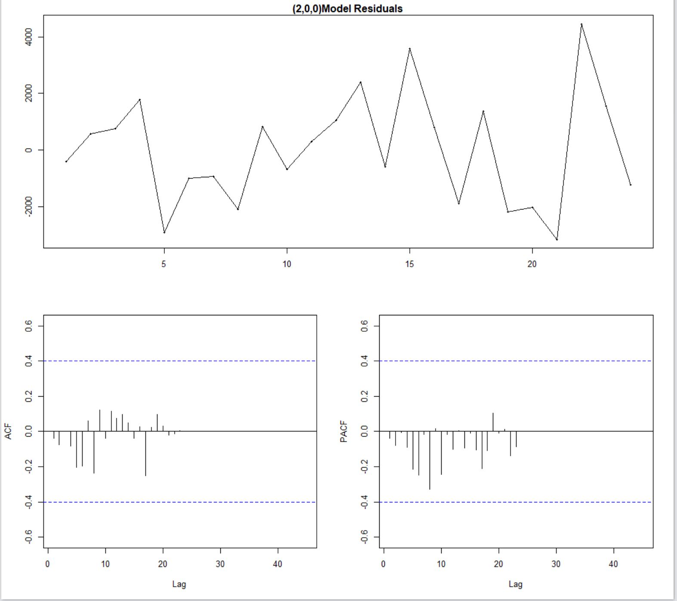
Accounting for Auto-Correlation
ACF & PACF: Measures to identify correlations between time lags.
Accounting for auto-correlation would prevent our model from over-fitting and becoming unreliable.
Notes:
We also have to account for autocorrelation to prevent our model from over fitting and becoming unreliable

Slide 31
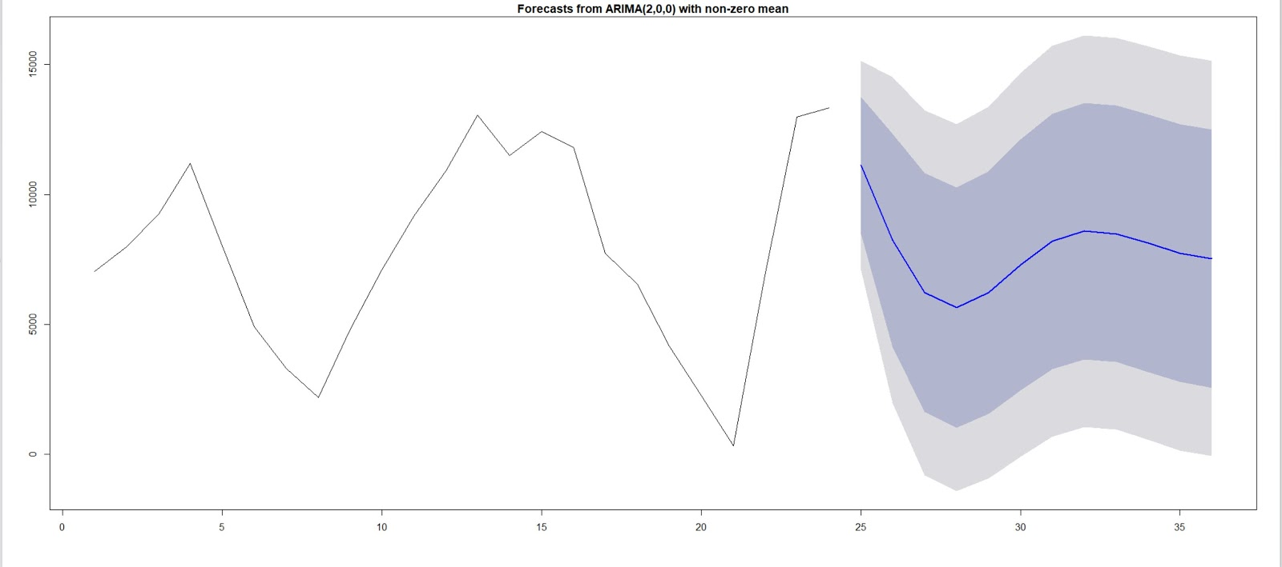
Forecasting for the next 6 months
Assumptions:
Homoscedasticity
No seasonal component. Intuitively, demand for cycling may reduce in winter and peak in summer
Applying forecast to only the most popular station as a gauge for all stations, might lead to atomistic fallacies.
Notes:
Hence, we forecast using Arima model (2,0,0).
There are a few assumptions in place:
Homoscedasticity
No seasonal component
Leading to atomistic fallacy
It assumes that there is homoscedasticity, that is variance is constant over time. It also assumes that there is no seasonality component. We can observe from the time-series that there is indeed some seasonality and intuitively, we can attribute that to things like the seasons in weather where demand for cycling may reduce in winter and peak in summer, We are also applying the forecasting only to the most popular station as a gauge for all stations so it might lead to atomistic fallacies.

Slide 32

Business Insights
Use forecasted demand to adjust the supply of bikes in each station.
Reduce wastages and optimize assets to maximize revenue.
For this most popular station, redistribute its bikes to other stations which are expected to have to a surge in demand for the next 6 months.
Notes:
Applying forecasting model allows us to adjust the supply of bikes in each station.
Hence it reduces wastages and optimizes assets to maximise revenue.
For this most popular station, redistribute its bikes to other stations which are expected to have to a surge in demand for the next 6 months.

Slide 33

Conclusion and Summary of Insights
Focus on understanding our consumer segments
Concentrate on discovering the purpose of different rides to improve targeted advertising
Use weather conditions and profile of riders to develop dynamic pricing
Reduce wastages and optimize assets to maximize revenue with forecasted demand
Notes:
Now i would like to summarise our findings.
Repeat whatever that is on top
This descriptive stats combined with predictive stats do allow us to have a greater understanding of the current and future condition which explains why Business analytics is the sexiest job in the 21st century by Harvard business review.
Congratz to everyone here who is in this classroom. You have chosen the right choice!

Slide 34
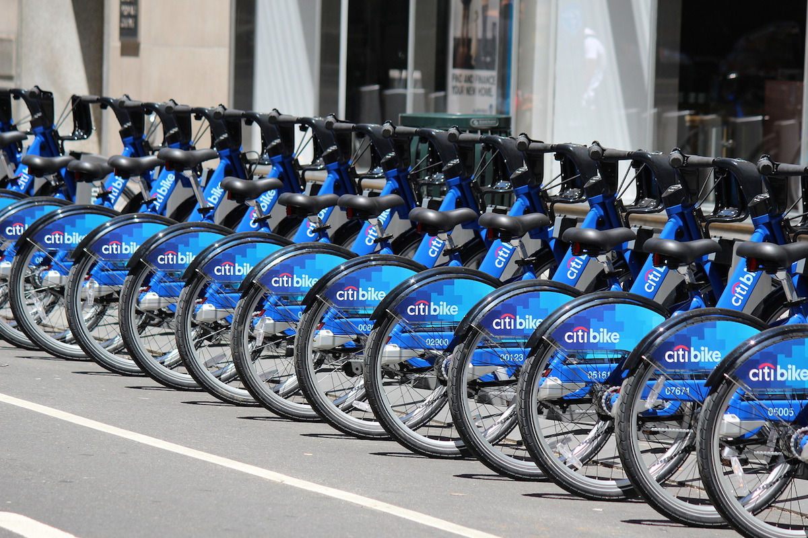
Thank You!
Thank You

